Slide 1
In the Shed
A slideshow of images from Museums Victoria's collection depicting men's
sheds, hobbies, jobs and pastimes from the twentieth century.

Slide 2
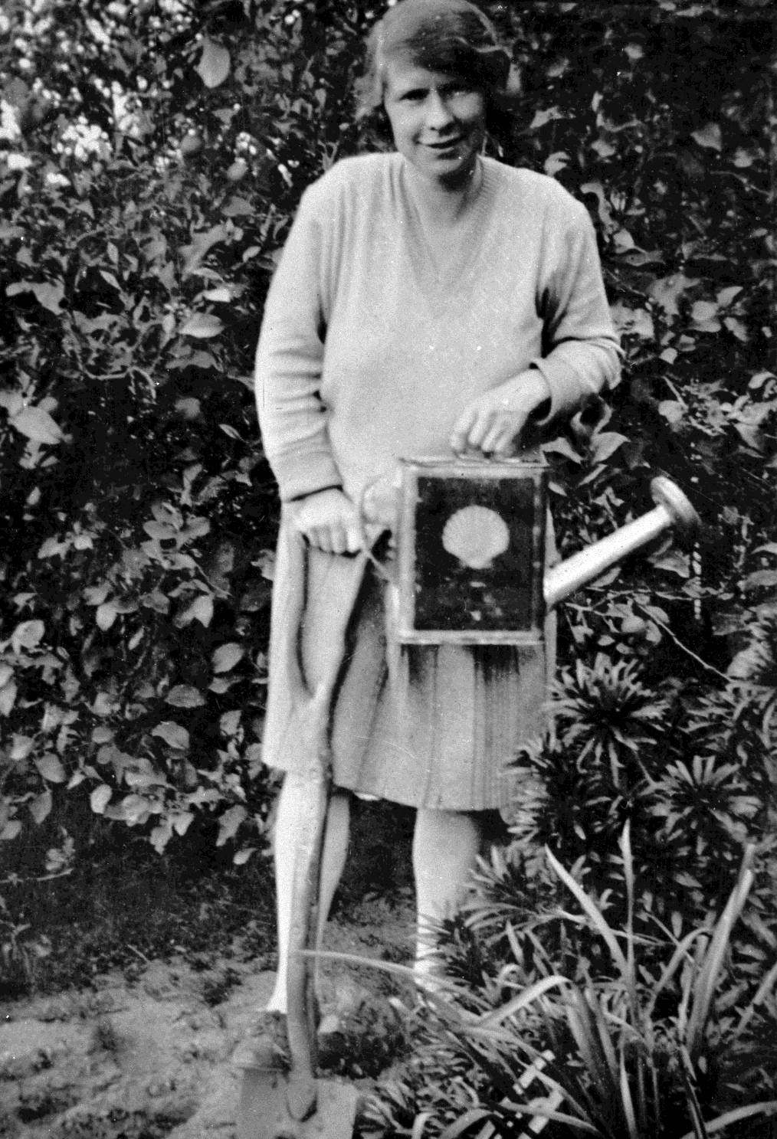
Woman tending to her garden with homemade watering can.
Photographer: Rogers Davidson

Slide 3
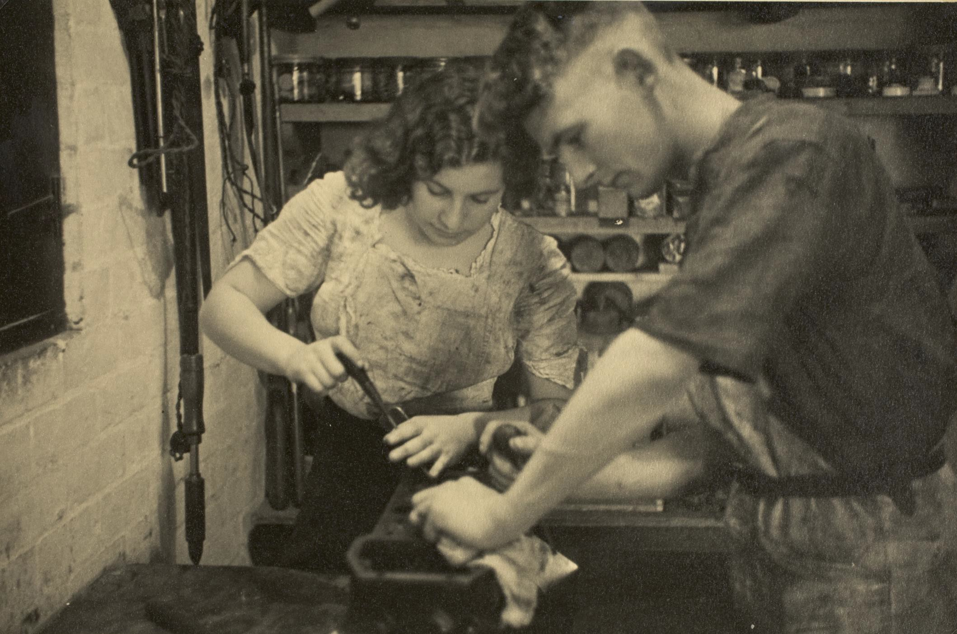
Boy & Girl Servicing Car, Preston West, 1935
Photographer: Roy Leibig

Slide 4
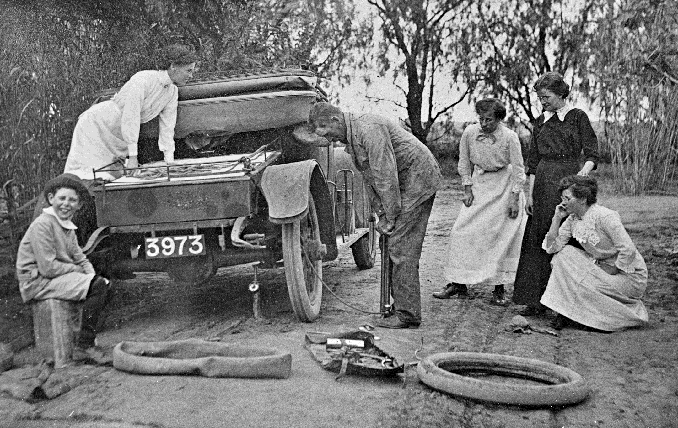
Group watch as man changes flat tire
Photographer: Lilian Louisa Pitts

Slide 5
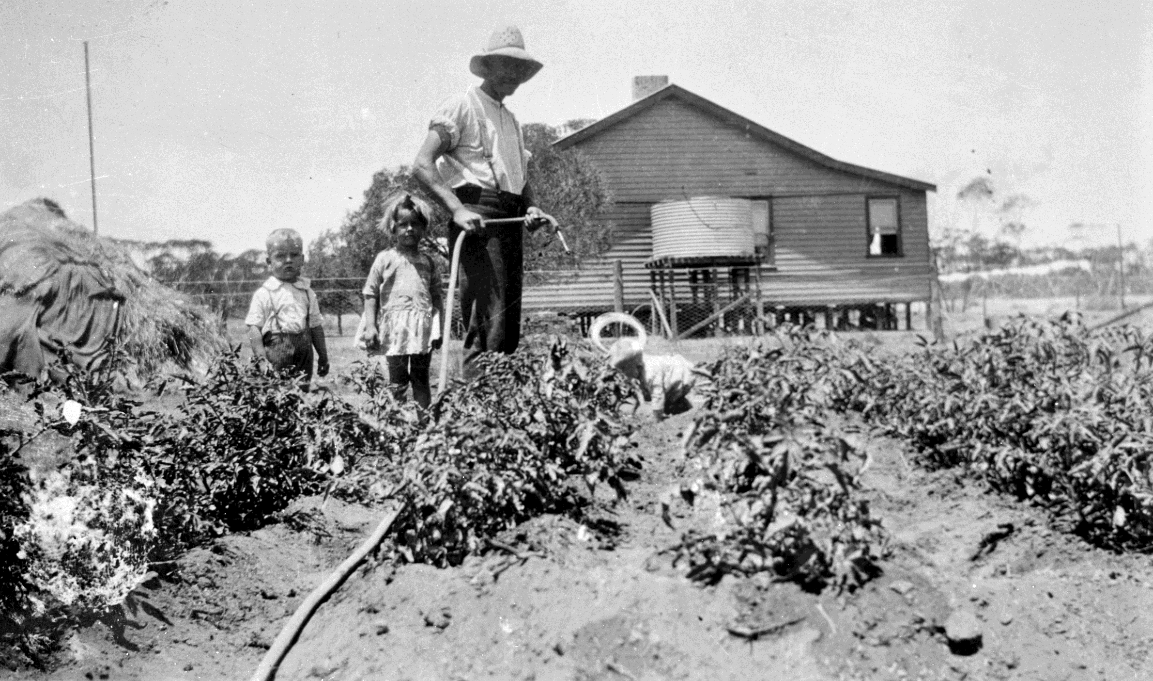
Man working in the garden with children
Photographer: Unknown

Slide 6
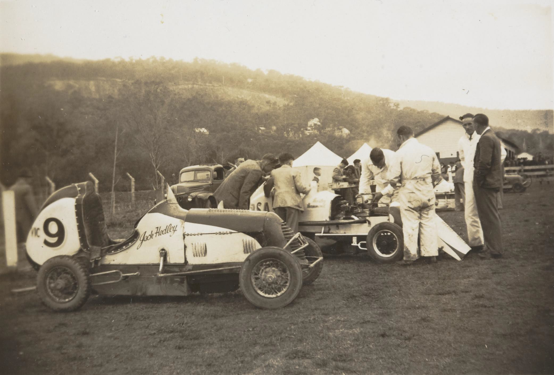
Men work on midget race car, aside the 'Jack Hedley' racer.
Ferntree Gully 1948
Photographer: Betty Watkins

Slide 7
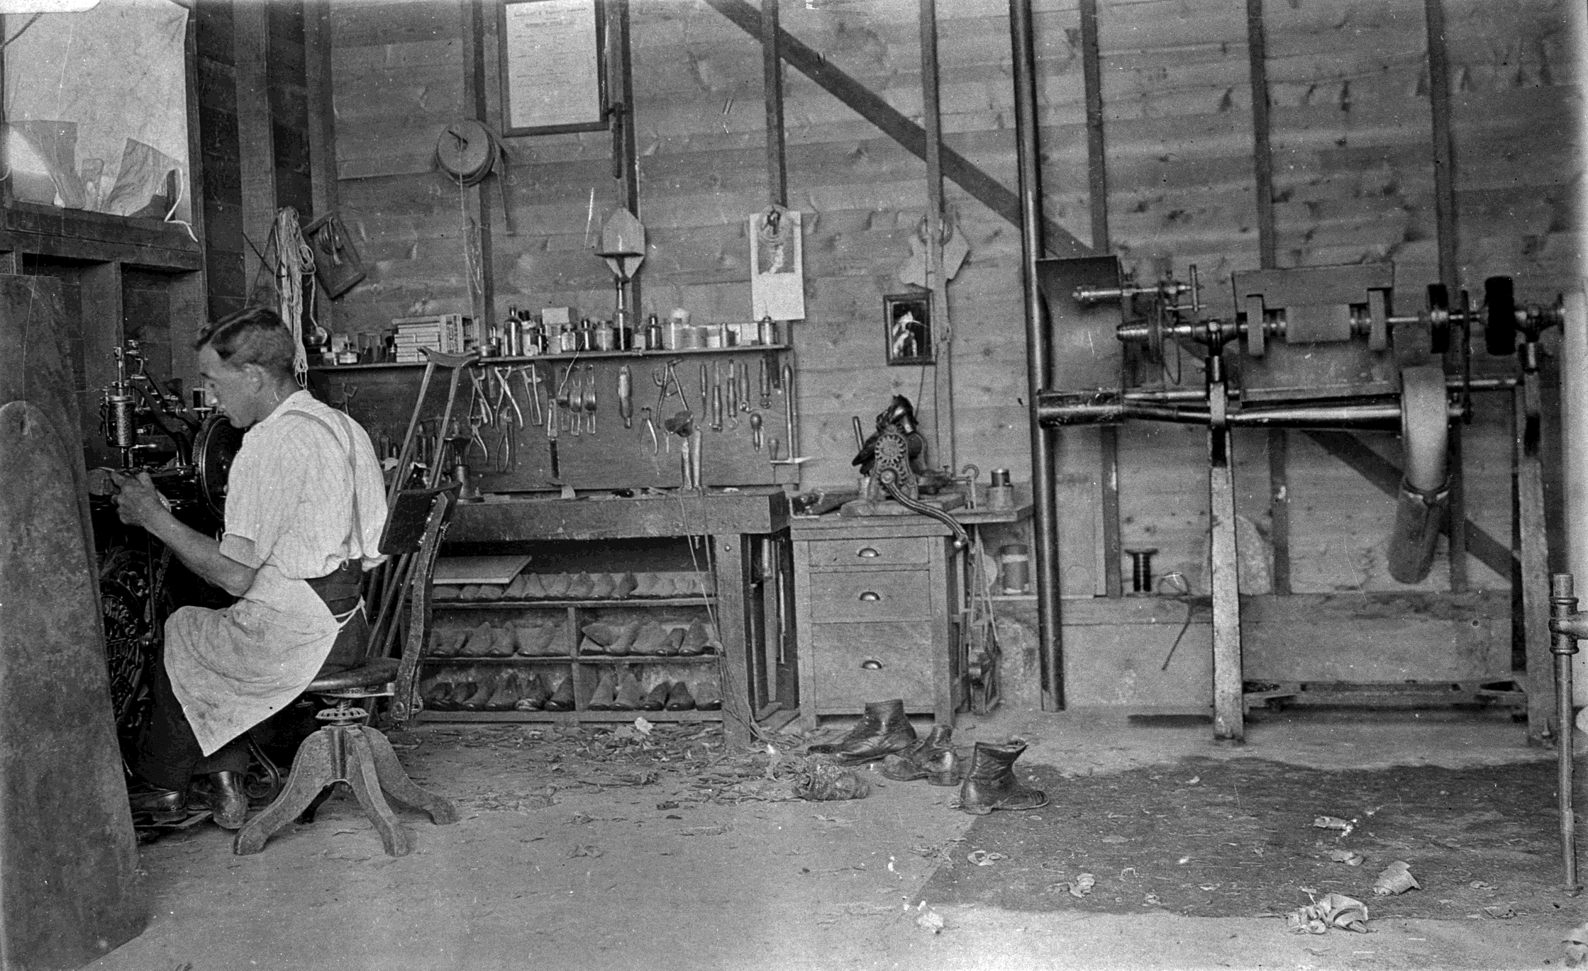
Boot & shoe repairer in his workshop.
Alphington 1926
Photographer:
R. Wright

Slide 8
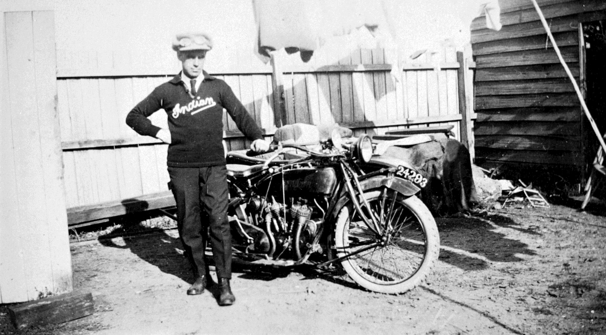
Man standing beside his motorbike in backyard
Digitiser: Sally Rodgers Davidson

Slide 9
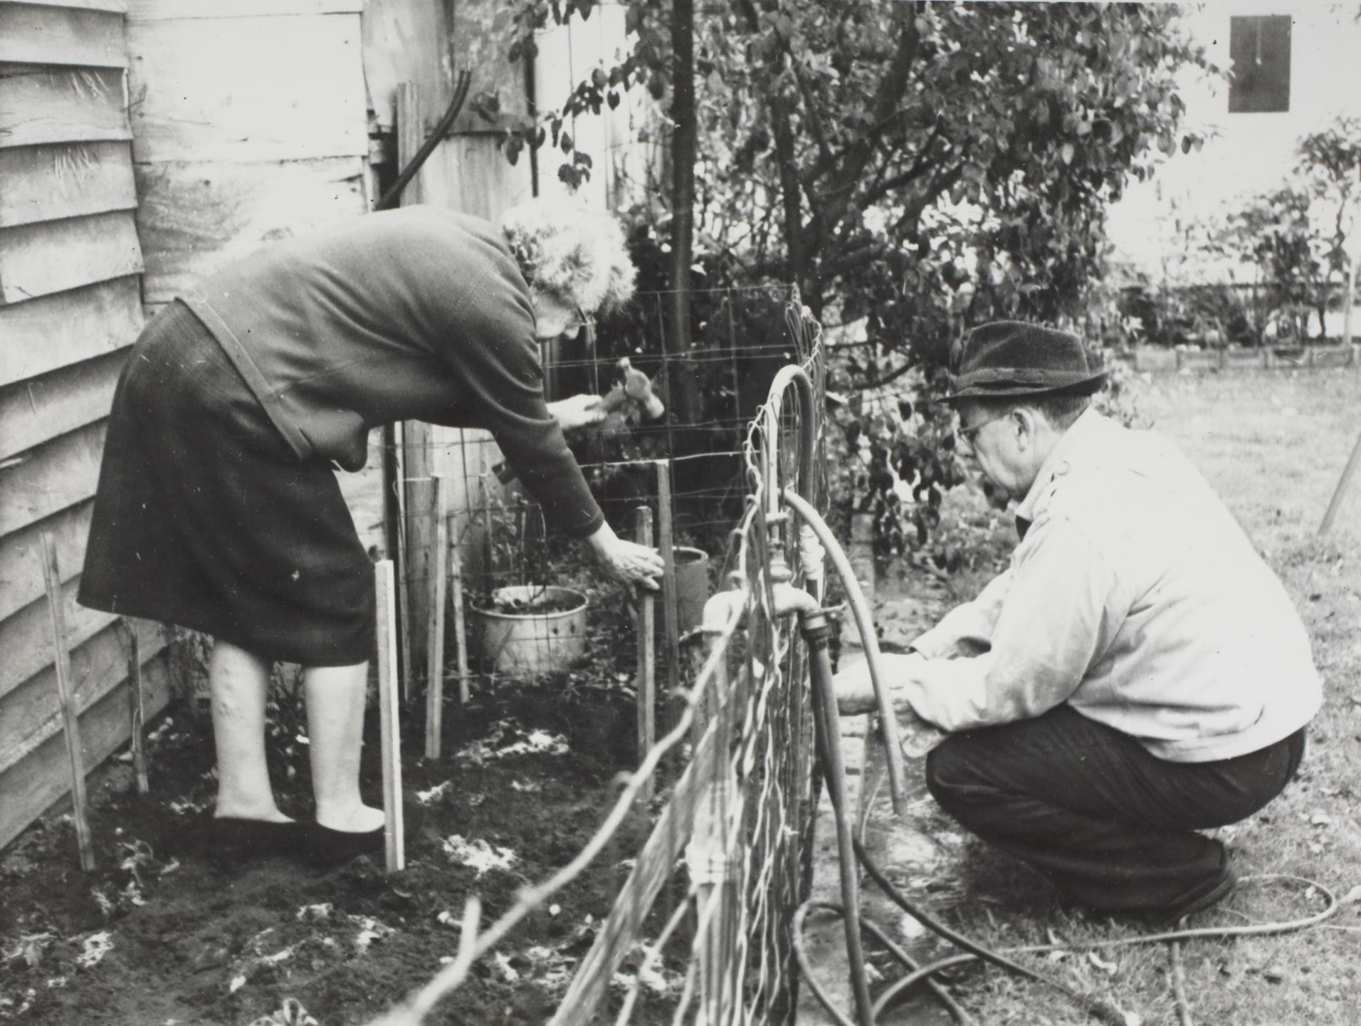
Woman & Man Gardening in Backyard, Caulfield, 1968
Photographer: Russell Beedles

Slide 10
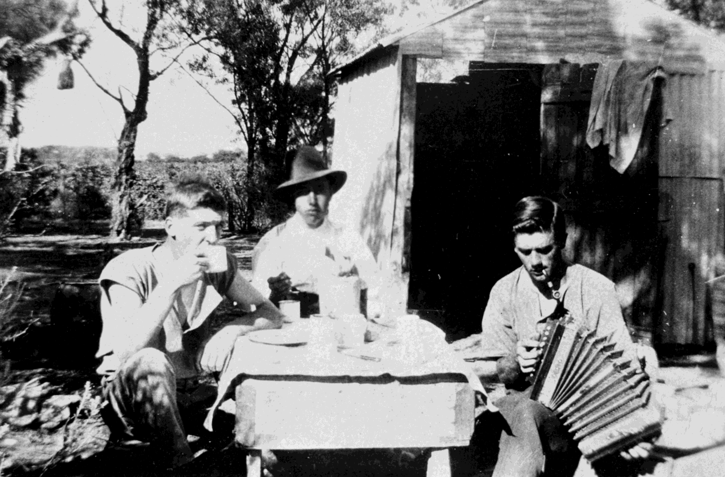
Three agricultural workers enjoy a spot of lunch with music
Digitiser: Sally Rogers Davidson

Slide 11
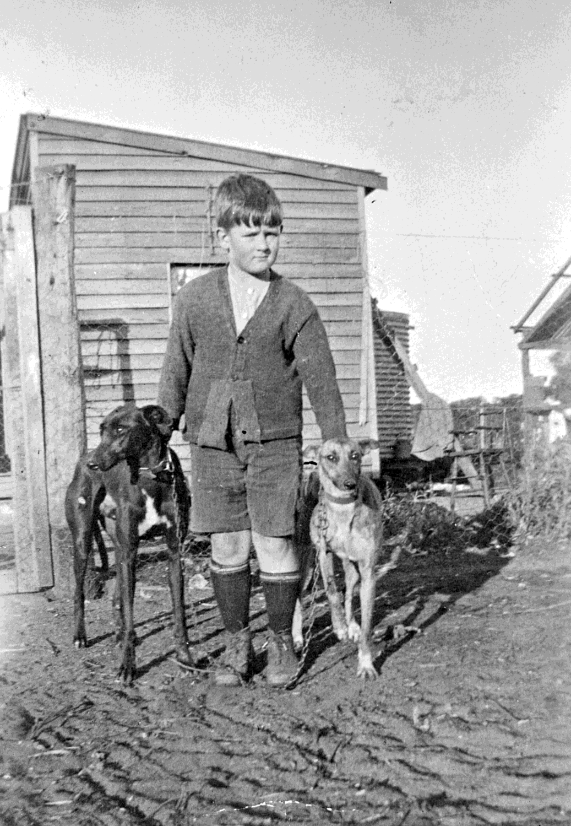
A boy stands between two greyhounds.
Managatang Vic 1934
Photographer: Unknown

Slide 12
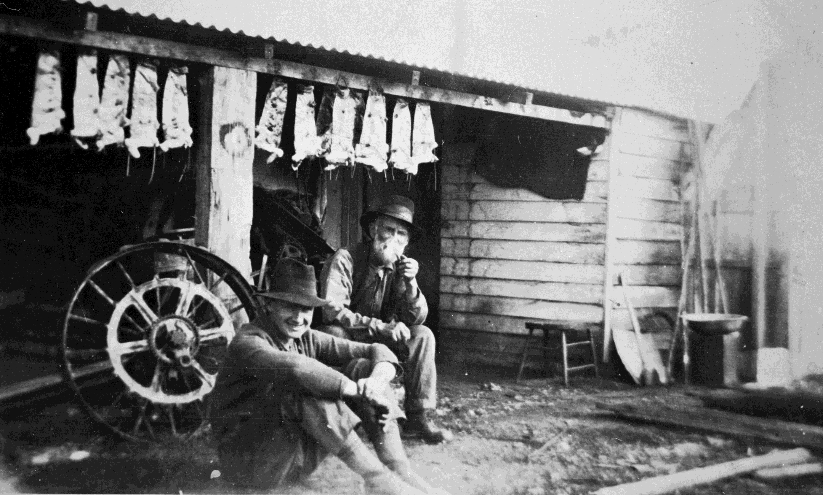
Two men seated in front of a shed with rabbit skins hanging from the rafters.
Photographer: Unknown

Slide 13
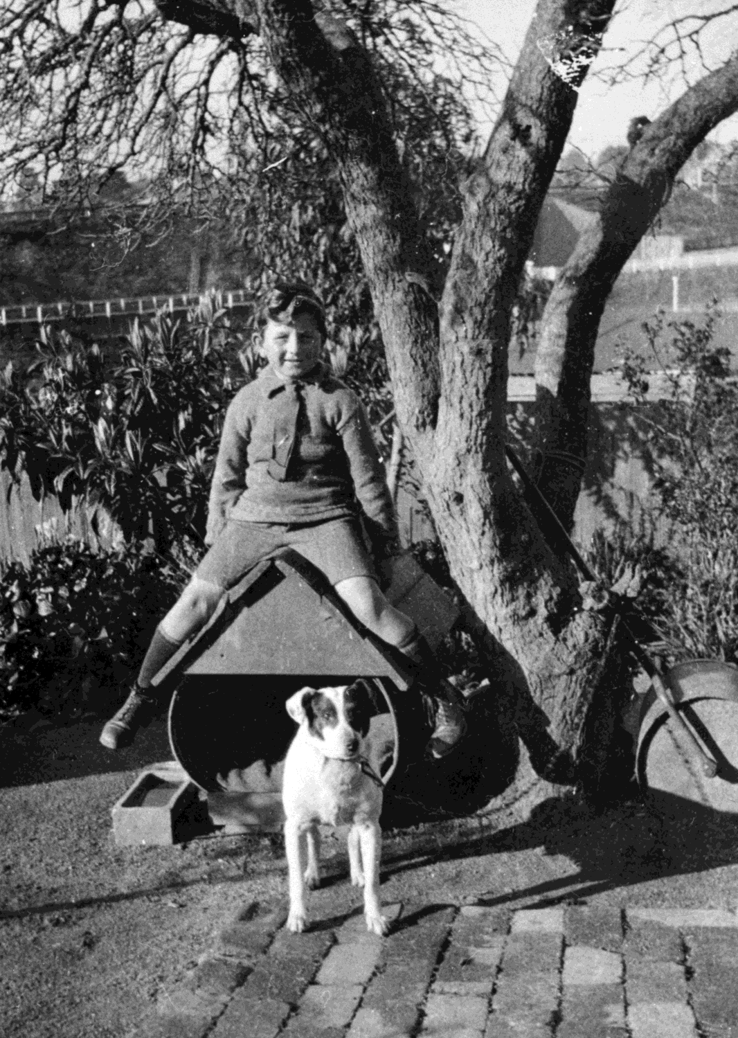
Boy sits atop dog kennel made from an oil drum, with his pup 'Pat’
Photographer: A. Howard

Slide 14
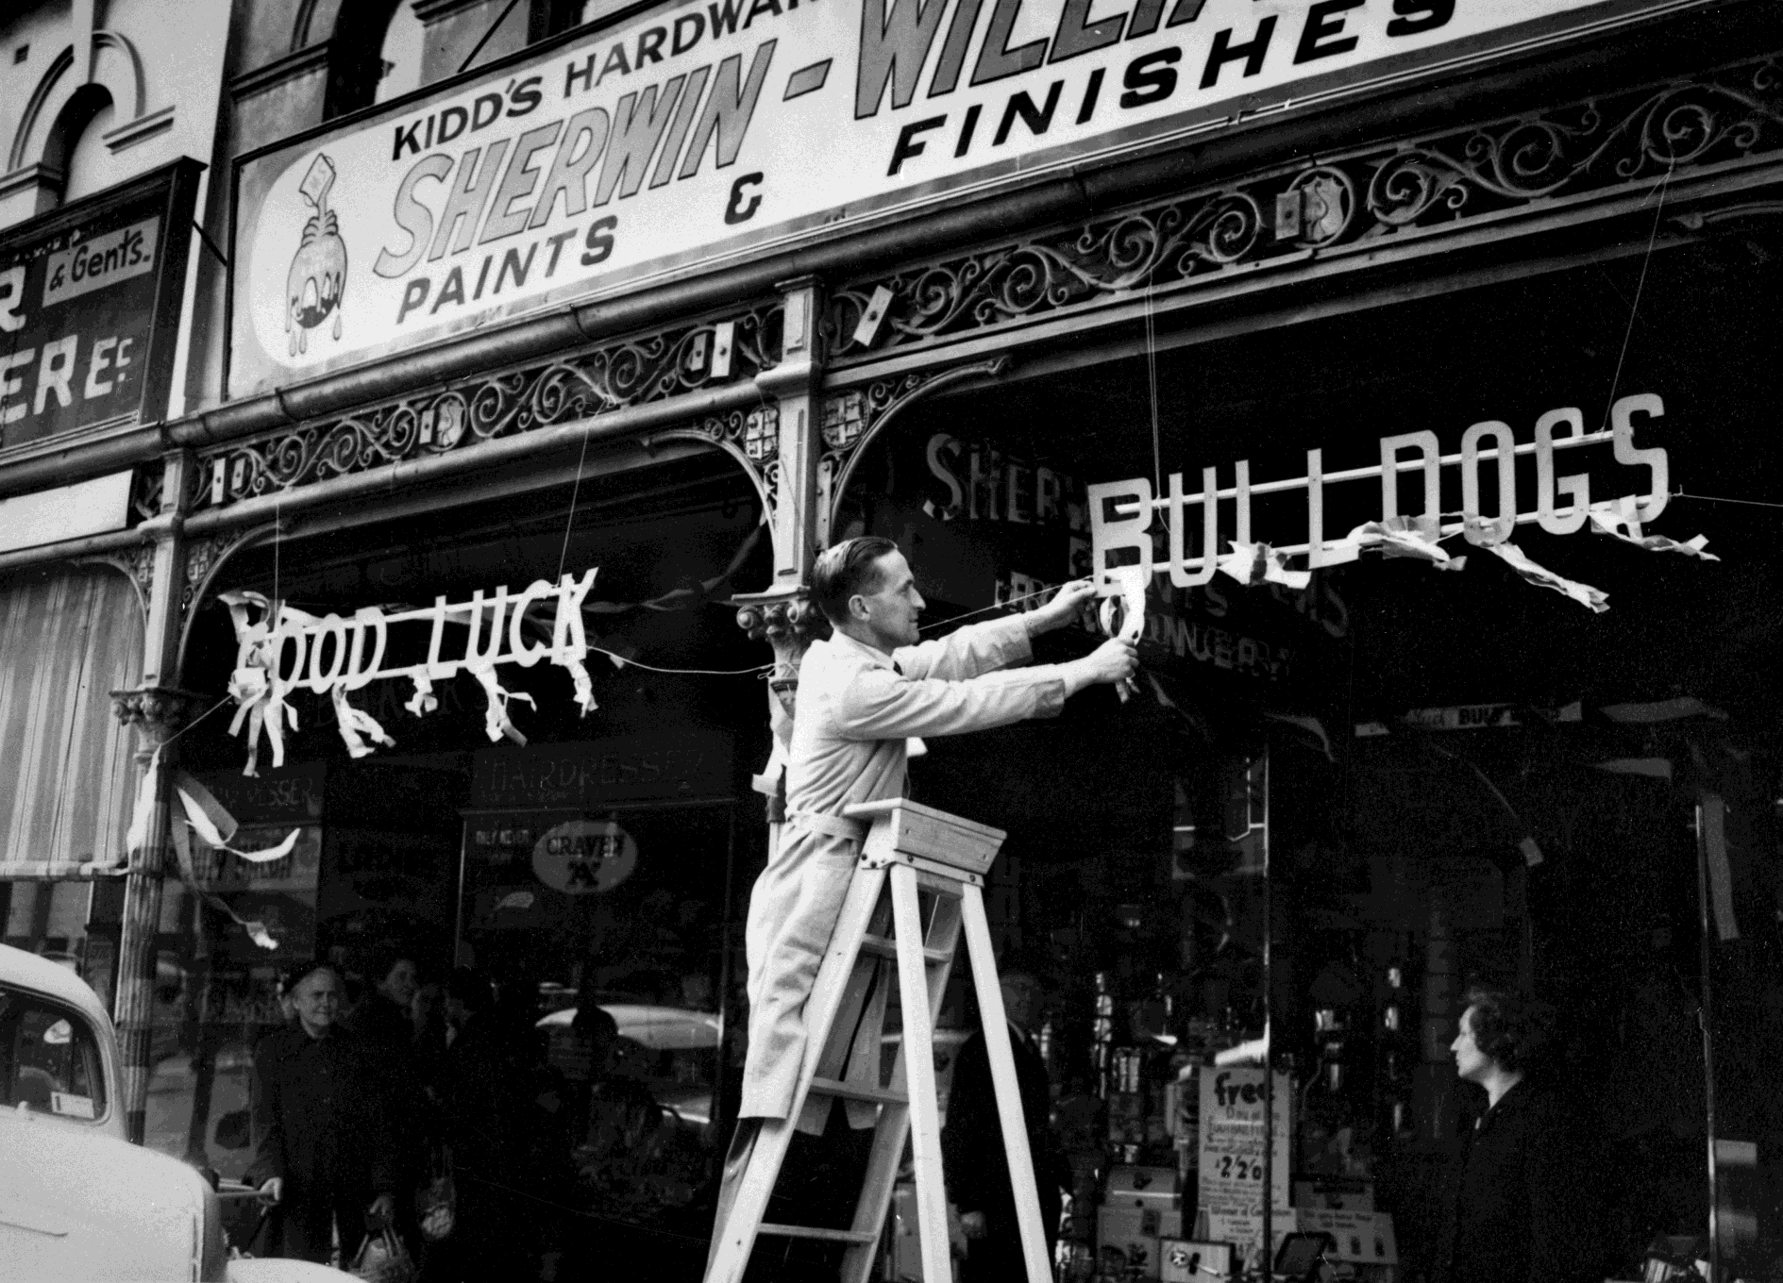
Hardware store putting up 'Good luck Bulldogs’ sign. Footscray, Victoria, 1954
Photographer: Unknown

Slide 15
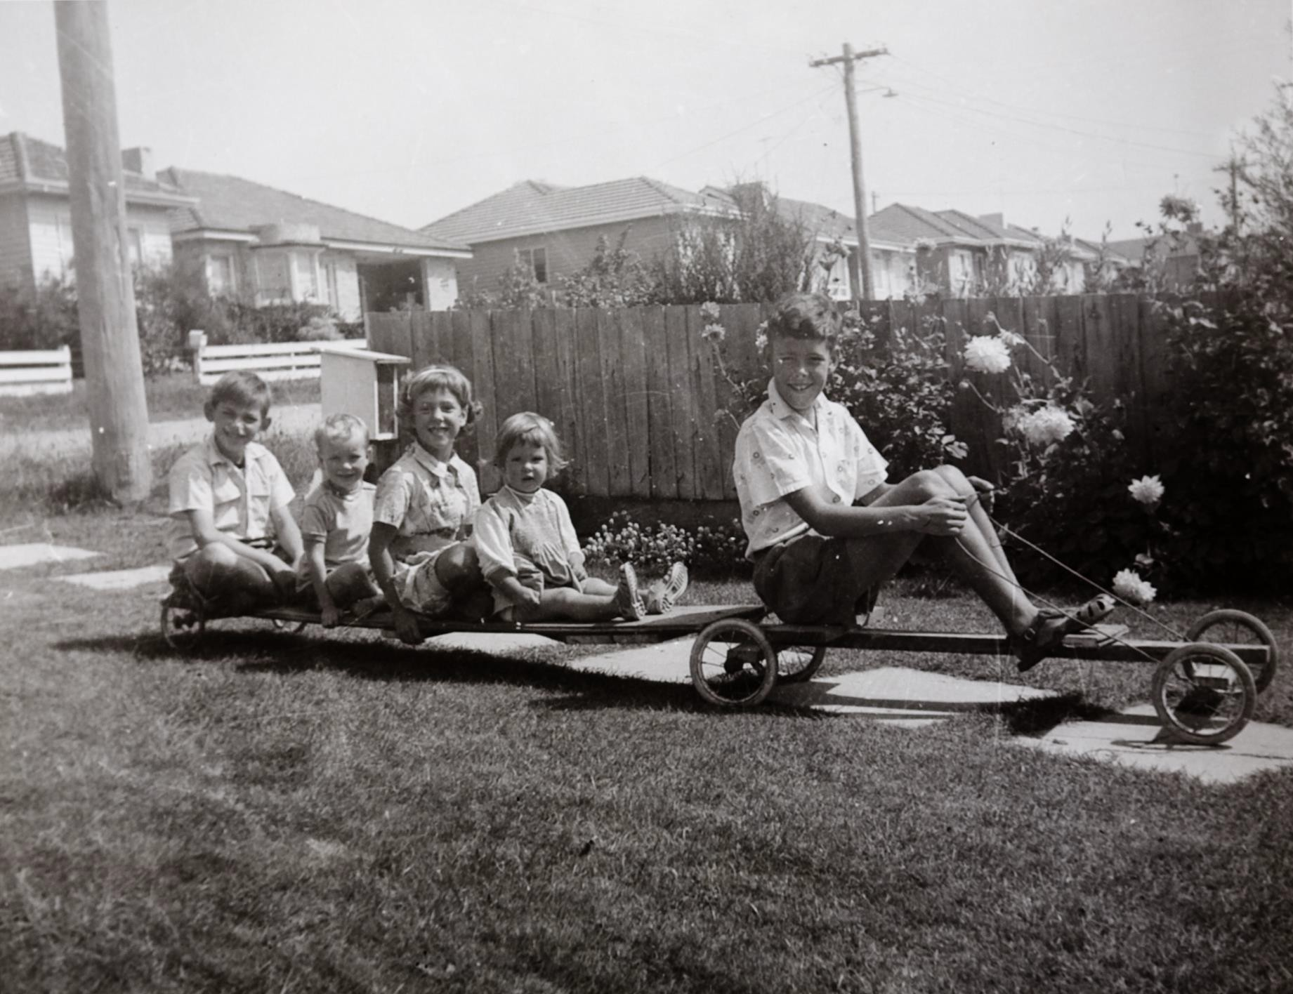
Boy on Billy cart towing four children on a trailer, Mount Waverley, 1961
Creator: Kathleen Margaret Gawler

Slide 16
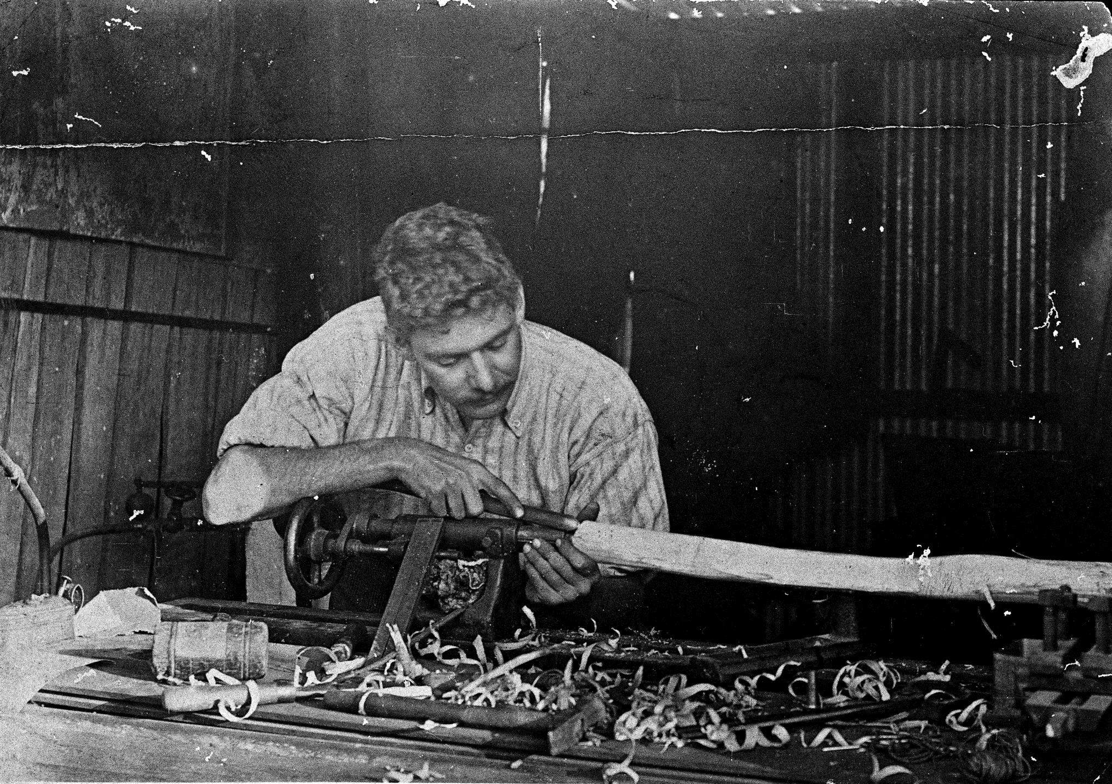
Man Using a Wood Lathe, Sydney, NSW
Photographer: Unknown

Slide 17
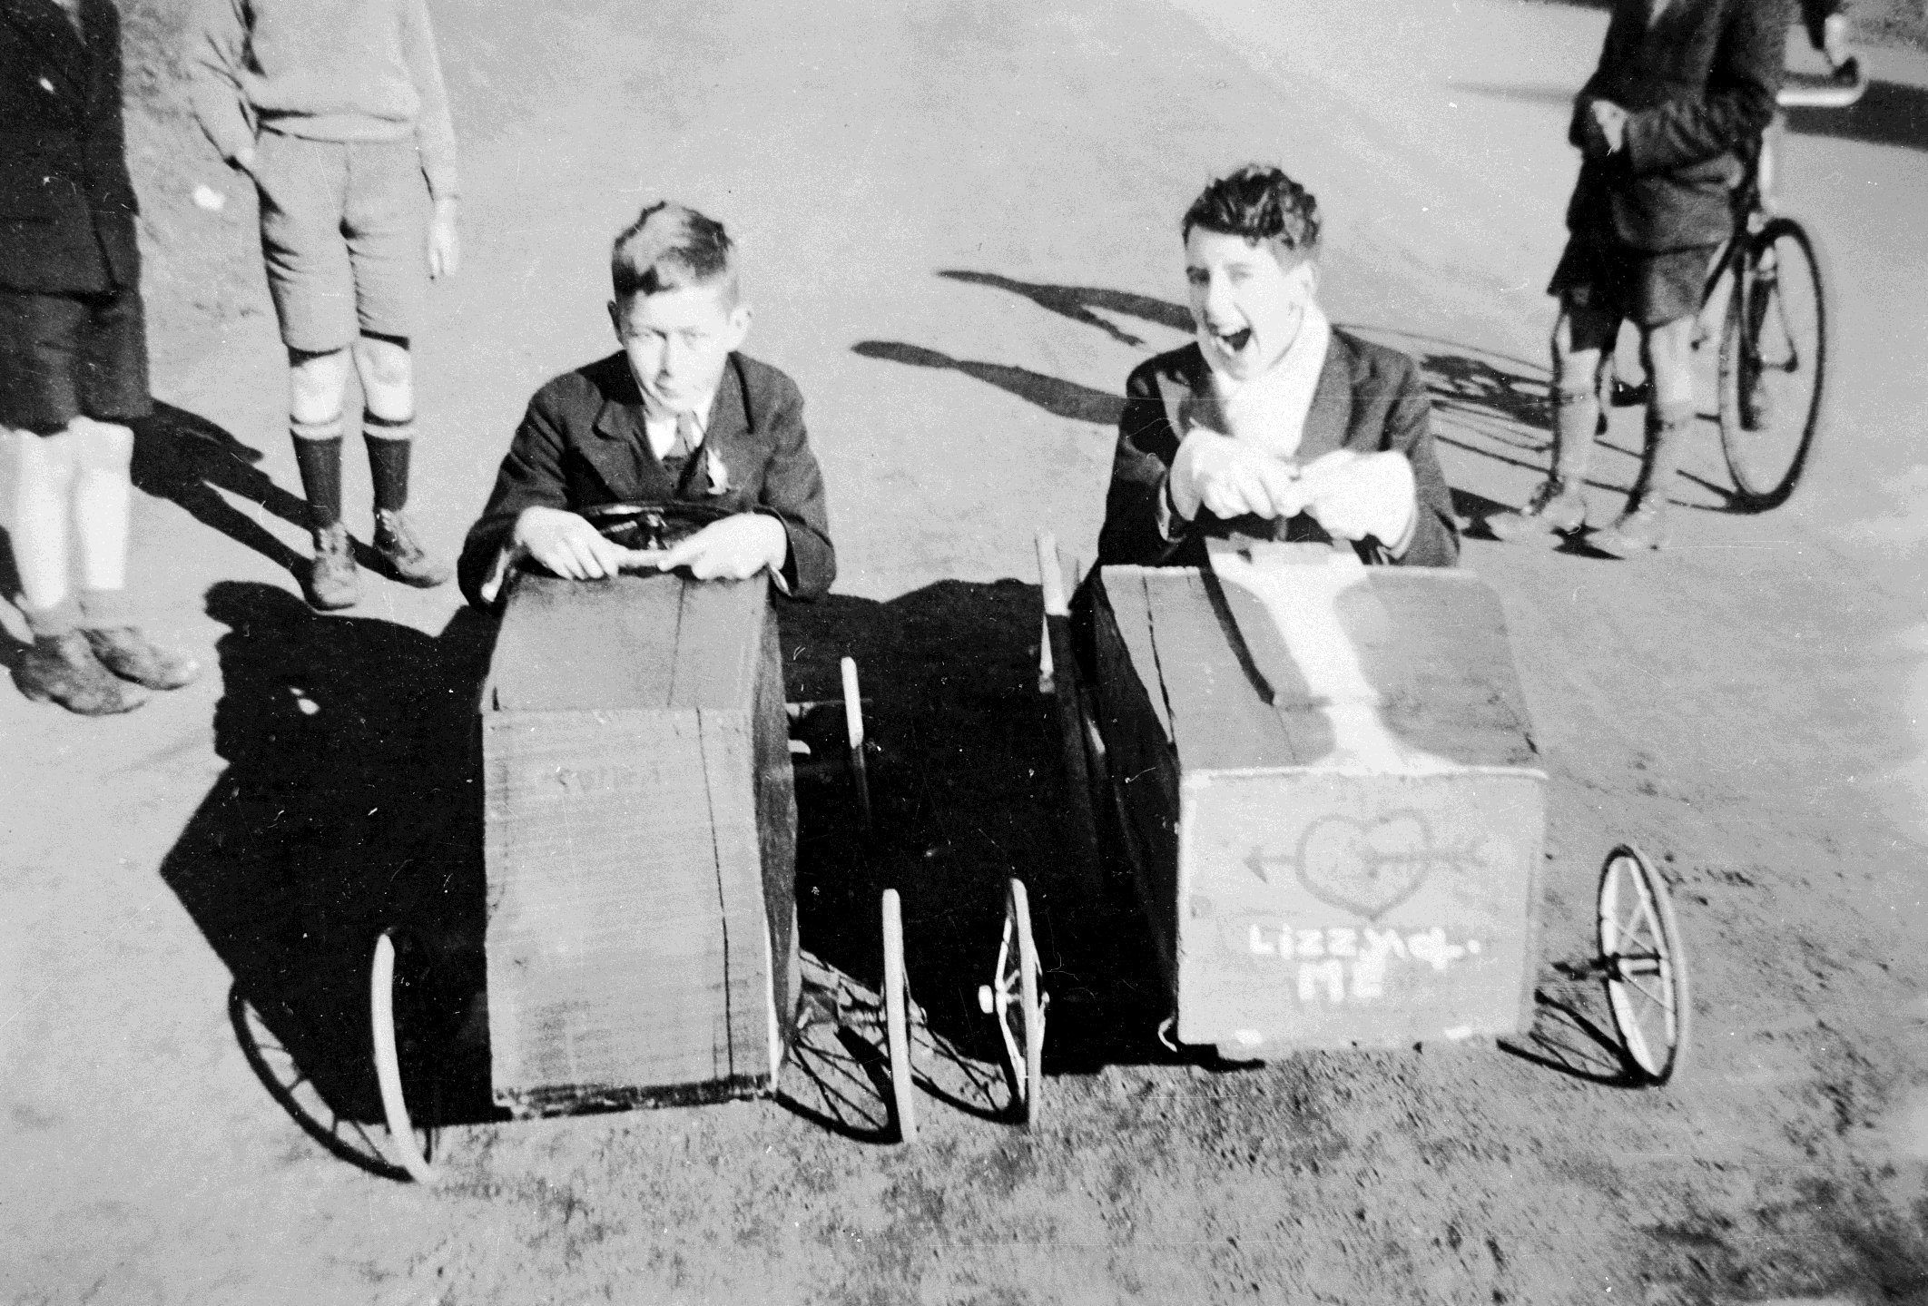
Two young boys in Billy carts.
Photographer: Joan Elijah

Slide 18
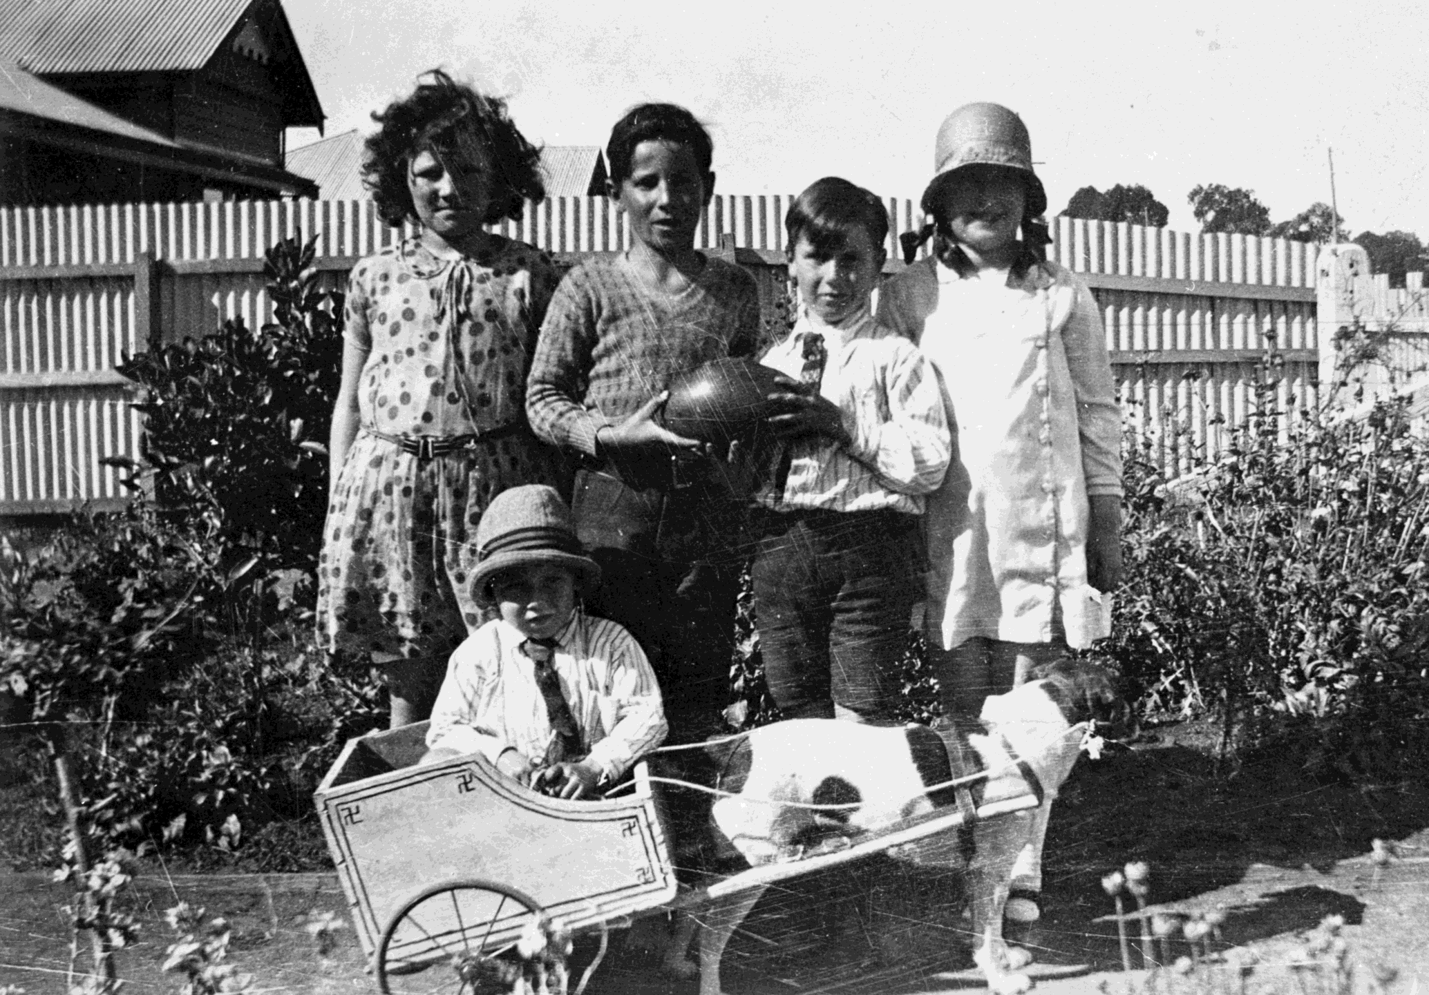
Five children in a backyard, one holding a football, one sitting in a Billy cart, Bendigo
Photographer:
Unknown

Slide 19
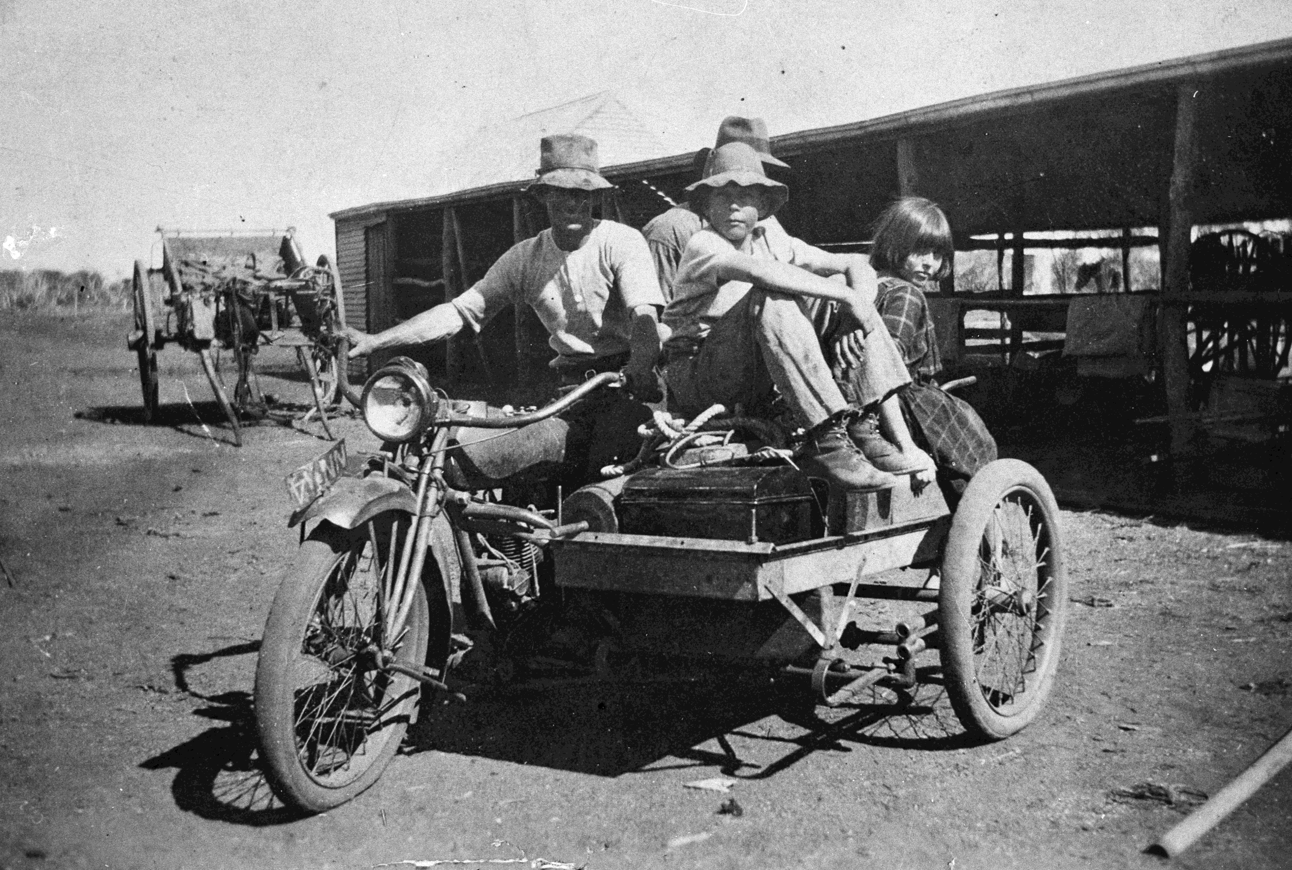
A man on a motorbike with two men and a young girl on the sidecar. Cul Culli, WA
Photographer:
Unknown

Slide 20
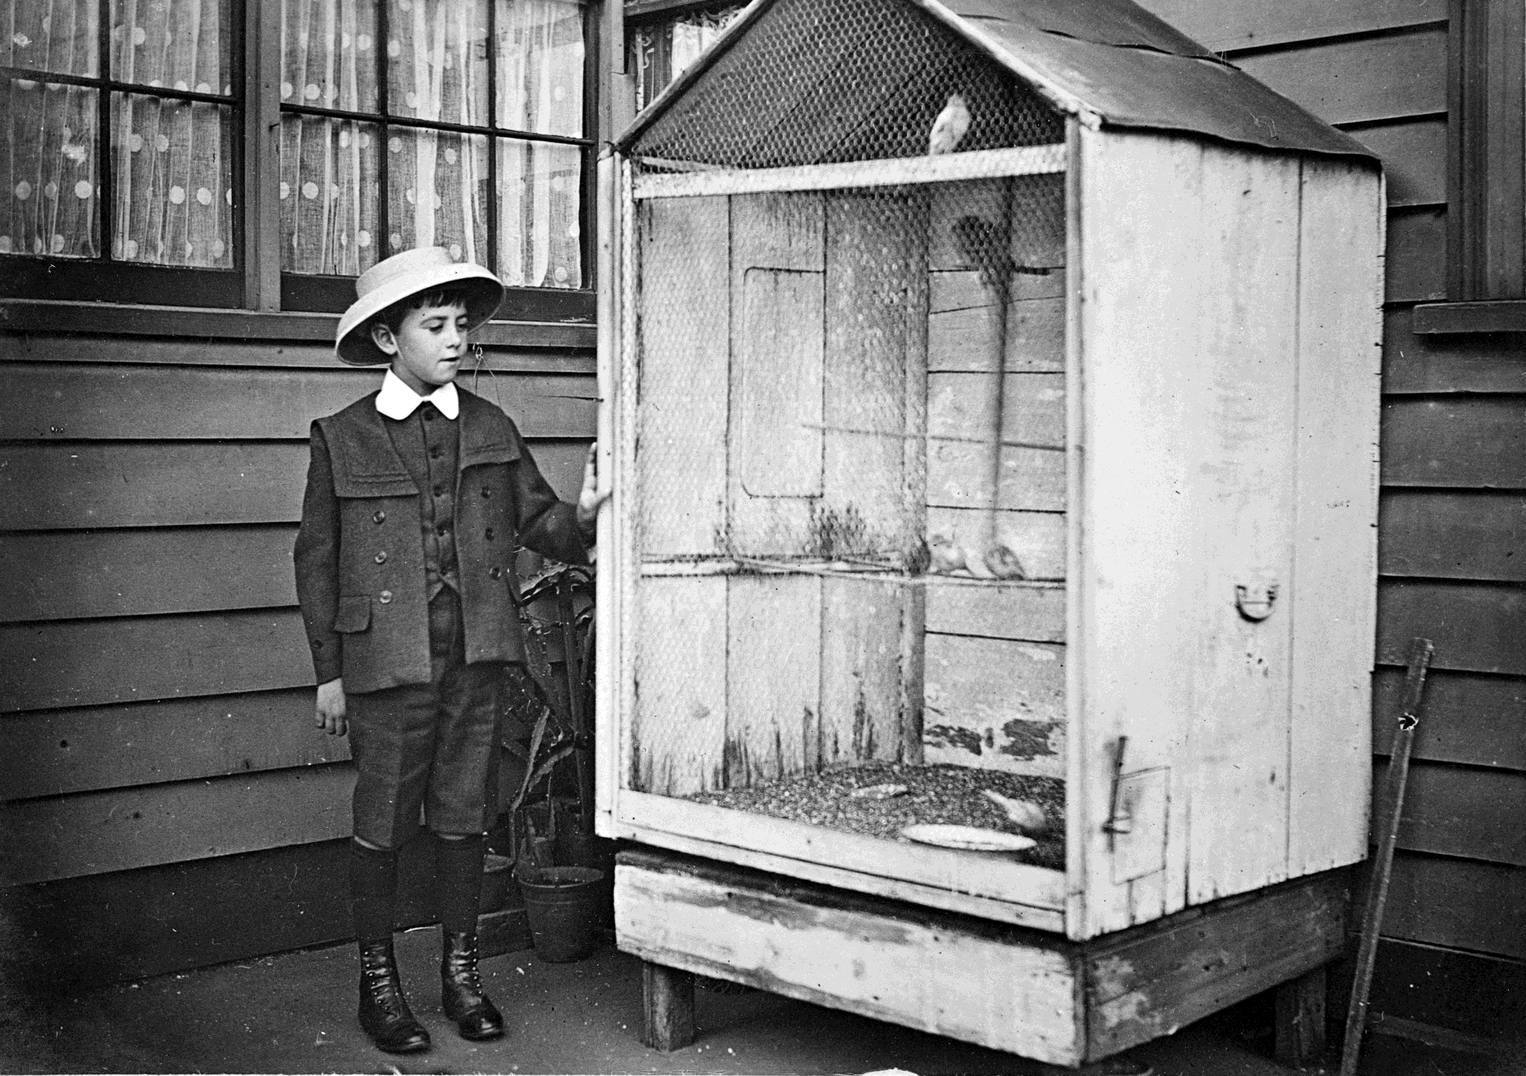
A boy with a large bird cage. There are birds inside the cage.
Photographer:
Unknown

Slide 21
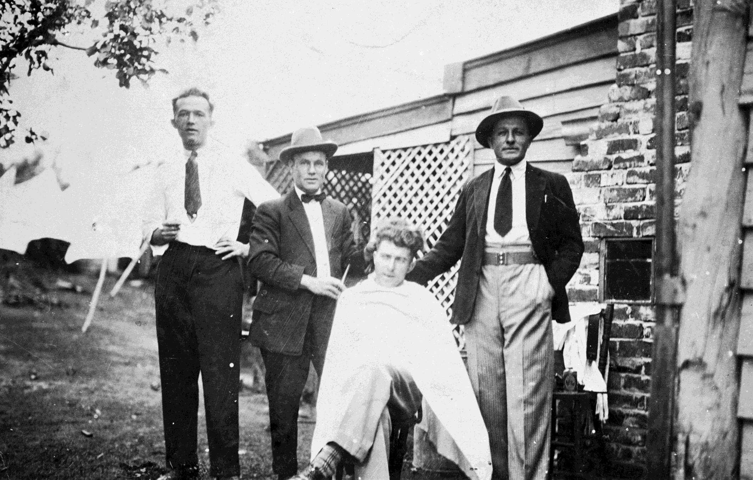
Outdoor barber shop, Wonthaggi, Vic
Photographer:
Unknown

Slide 22
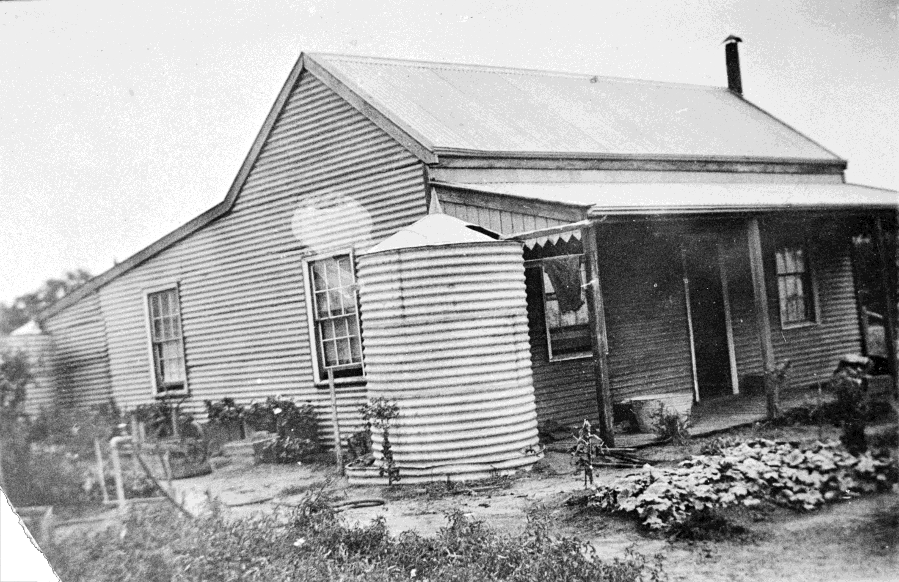
A corrugated iron farm house with two large water tanks and a flower garden. Horsham area
Photographer:
Unknown

Slide 23
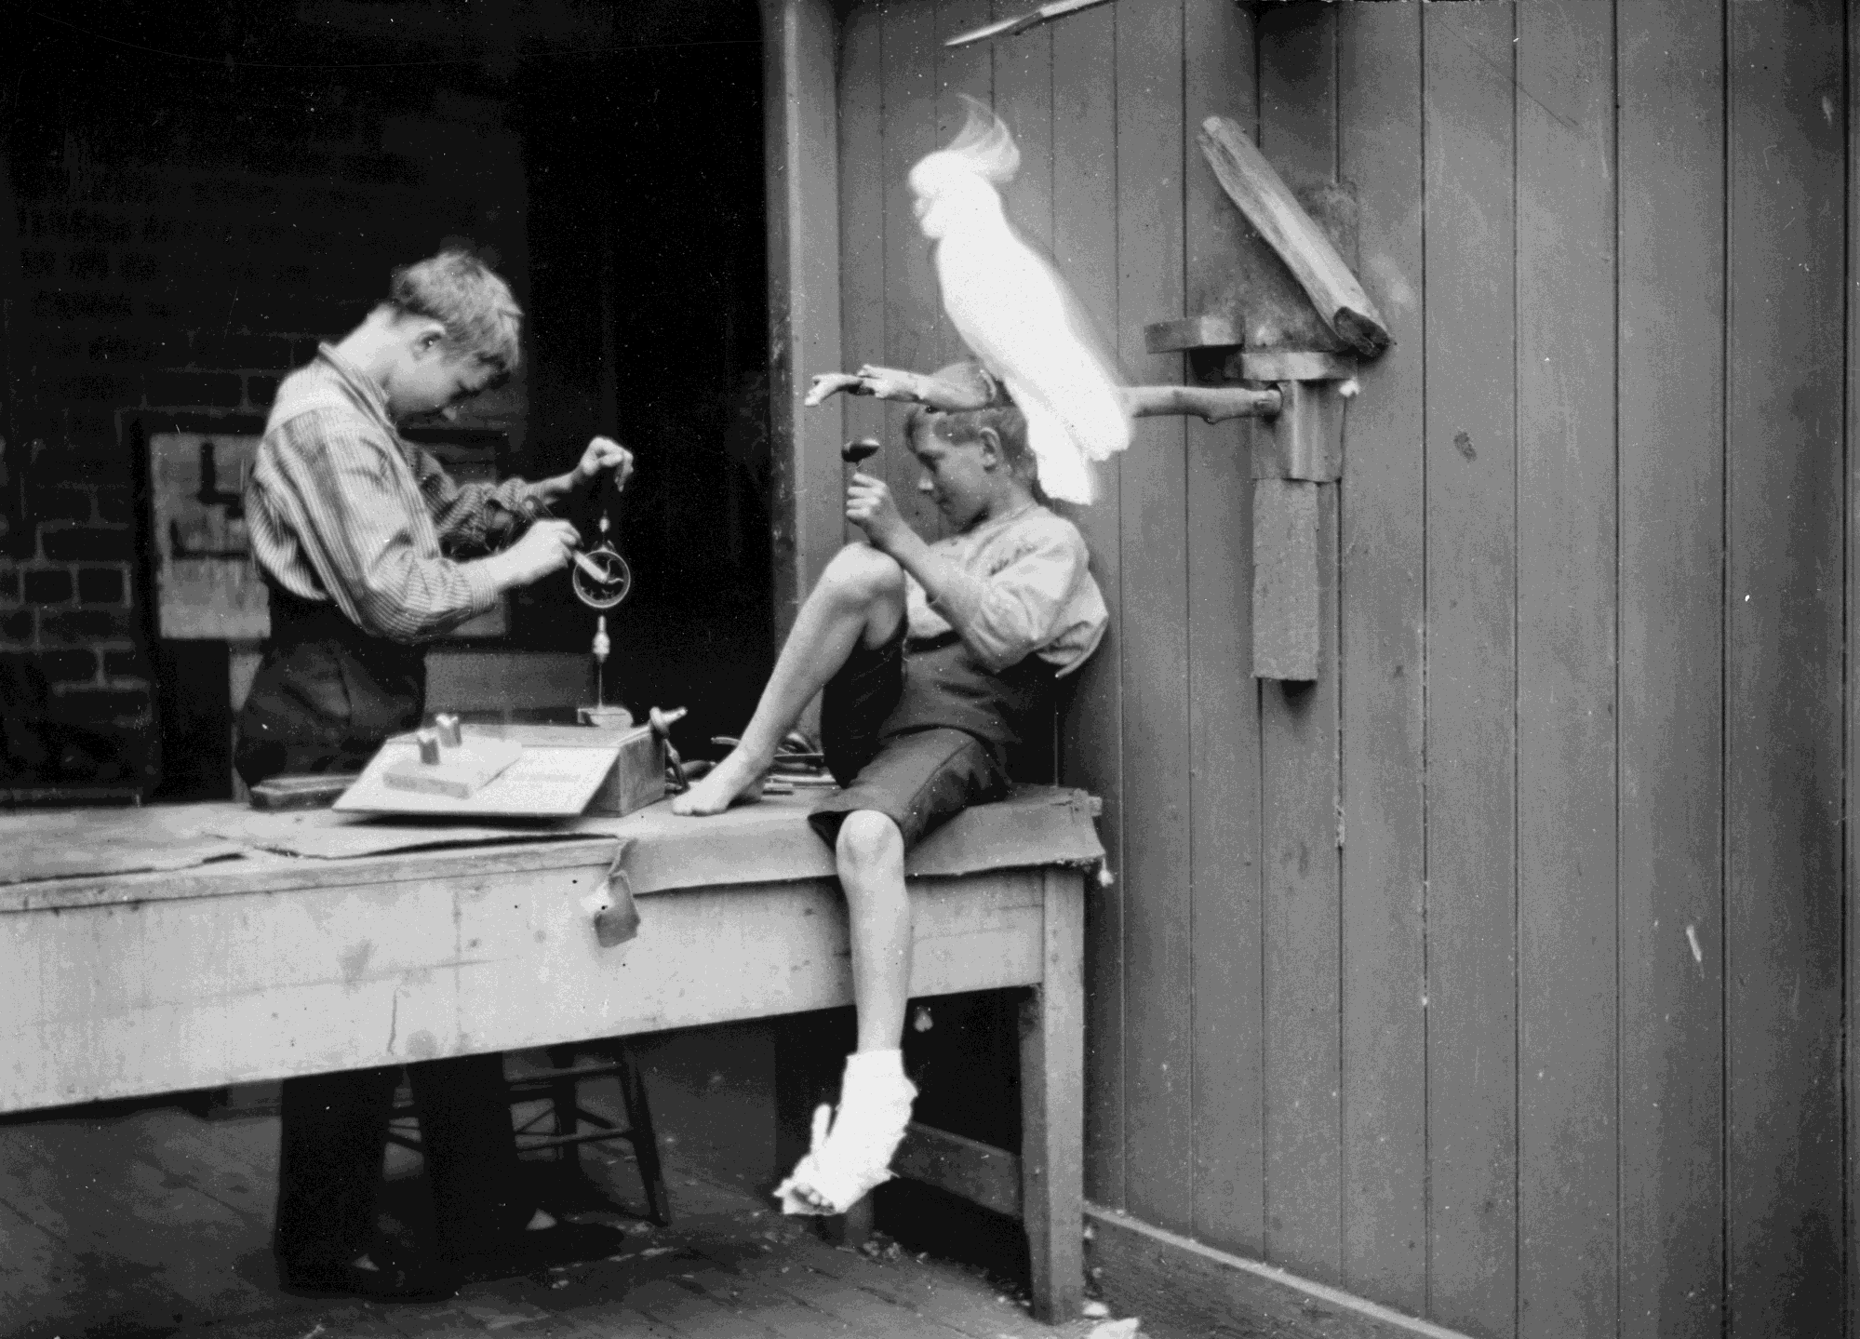
Two boys woodworking. One is using a hand held drill. There is a large cockatoo on a perch behind them. This photograph was taken in the backyward of the Beckett residence, 'Alma', High Street, Northcote, Melbourne.
Photographer: Dr. Thomas George Beckett

Slide 24
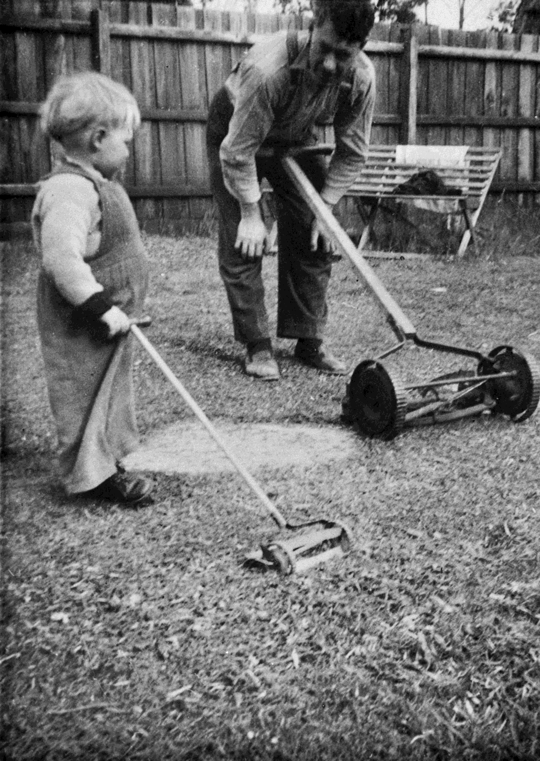
A father and son in a backyard. The father has a hand pushed lawn mower and the child a toy lawn mower.
Photographer: Unknown

Slide 25
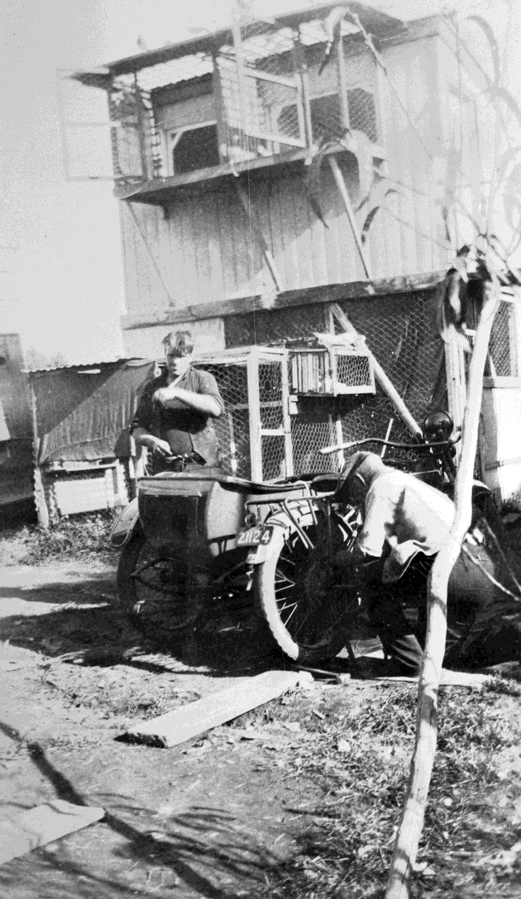
Two men working on a motor cycle in front of a pigeon loft. Alphington Vic, 1935
Photographer: Unknown

Slide 26
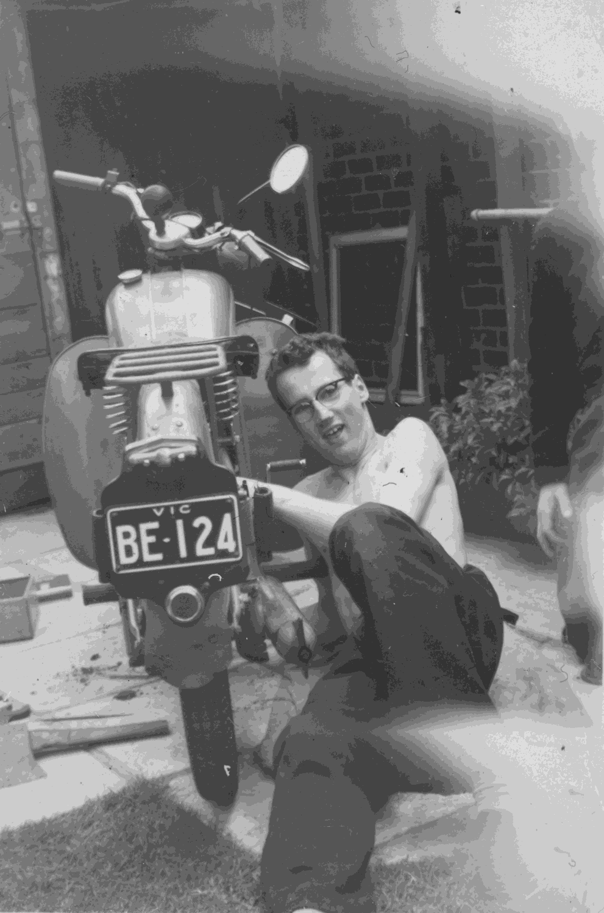
A young man lying next to a BSA Bantam motor bike, cleaning it.
Flemington 1956
Photographer: Unknown

Slide 27
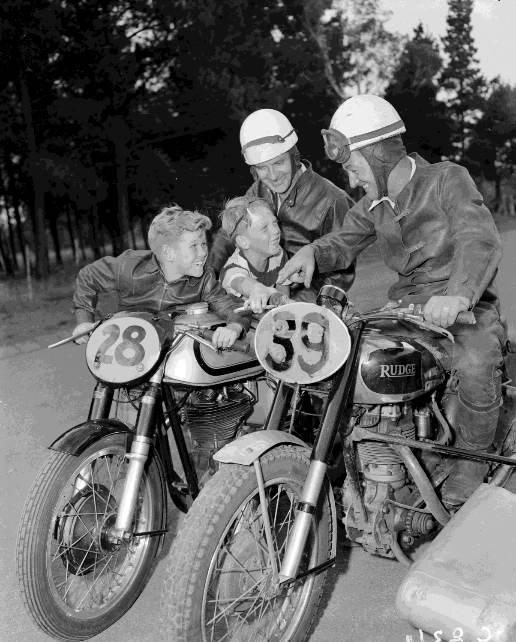
Two motorcyclists in protective clothing talking to two young boys along a roadside. One of the motorcycles is a Rudge with a sidecar attached.
Moonee Ponds 1954
Photographer: Laurie Richards

Slide 28
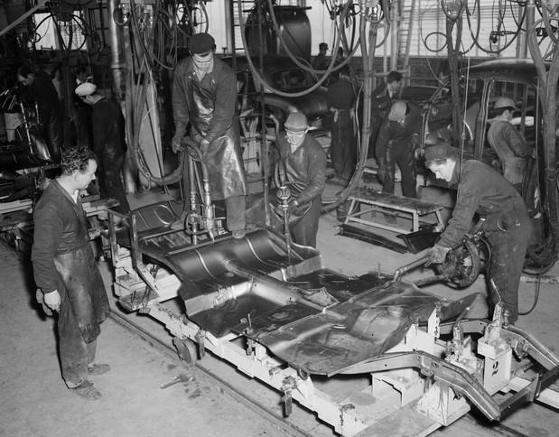
Workers are pictured on an assembly line in a motor vehicle factory. Three men are using tools and equipment on the base section of a motor car.
Photographer: Laurie Richards

Slide 29
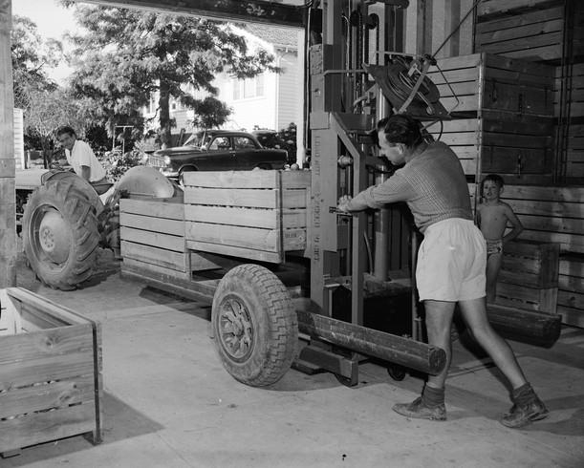
A male farm worker reversing a tractor towing a load of crated apples into a farm shed
Photographer: Laurie Richards

Slide 30
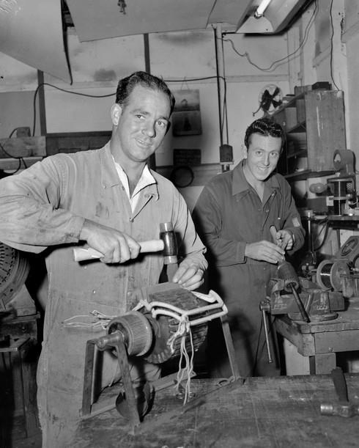
Two men repairing parts of industrial equipment in a workshop at a paper mill in Heidelberg
Photographer: Laurie Richards

Slide 31
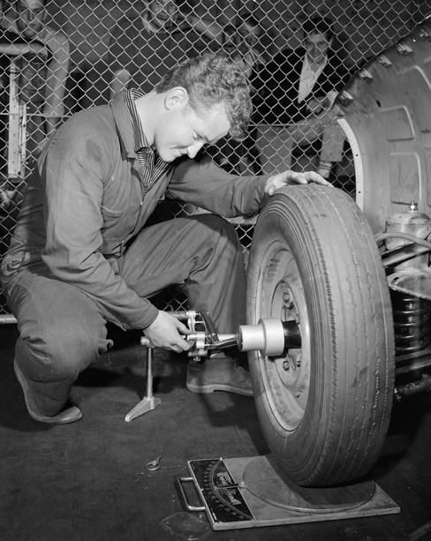
A motor mechanic changing the tyre of a motor vehicle
Photographer: Laurie Richards

Slide 32
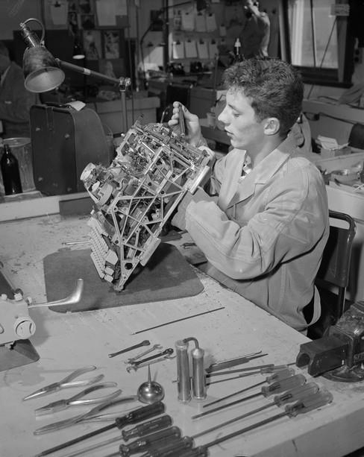
A factory worker testing the mechanism of a manual typewriter unit in a workshop at an office equipment factory
Photographer: Laurie Richards

Slide 33
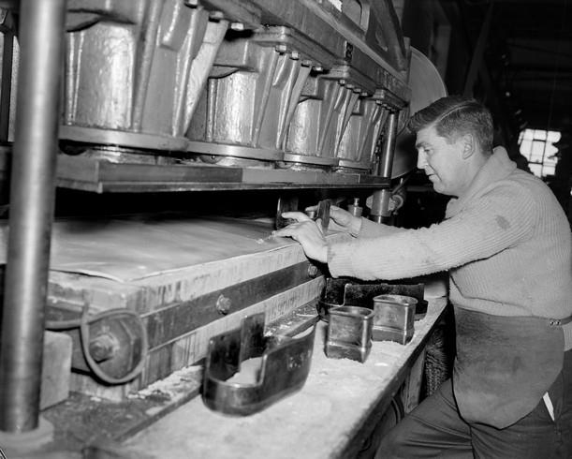
A factory worker operating a machine to cut shoe parts out of a sheet of leather using metal patterns
Photographer: Laurie Richards

Slide 34
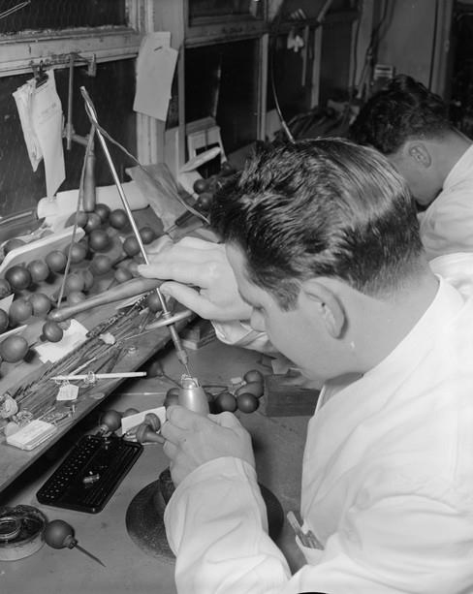
”Diamond cutters" a jeweller using a drill to shape a precious stone in a woman's ring
Photographer: Laurie Richards

Slide 35
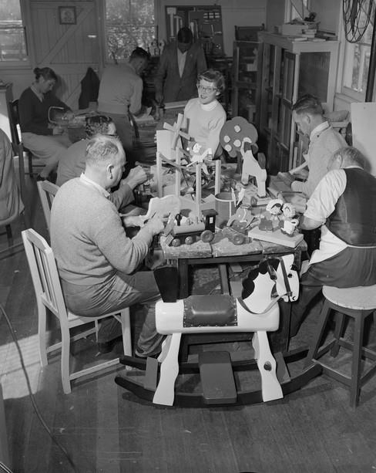
A group of men working in a Red Cross workshop producing wooden toys using hand tools
Photographer: Laurie Richards

Slide 36
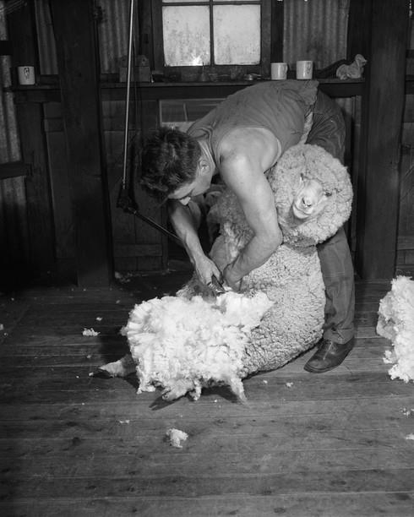
A male shearer shearing sheep with electric shears in a farm's shearing shed at Swan Hill, 1959
Photographer: Laurie Richards

Slide 37
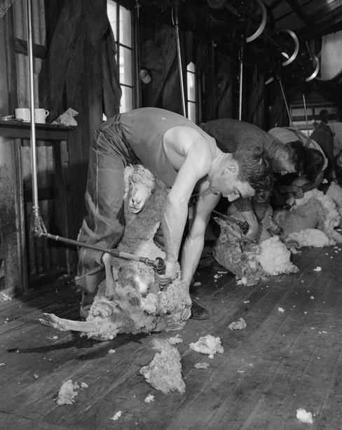
A group of male shearers shearing sheep with electric shears in a farm's shearing shed
Photographer: Laurie Richards

Slide 38
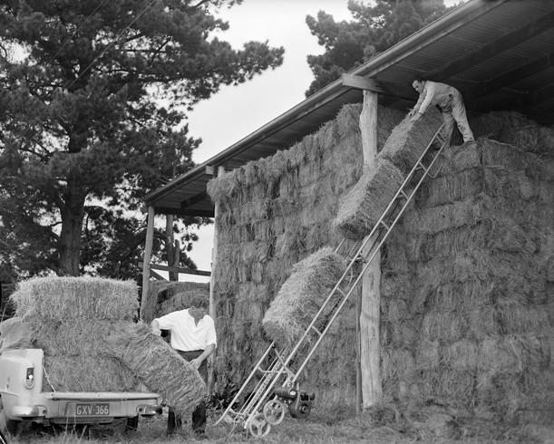
Two farm labourers unloading hay bales from the back of a Holden ute and using a conveyor to transport them to the top of a pile in a storage shed
Photographer: Laurie Richards

Slide 39
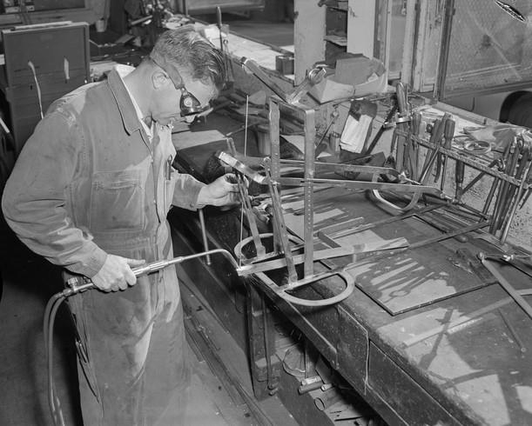
A male manufacturing worker welding part of a metal leg elevation device for above a hospital bed in a workshop at the Royal Children's Hospital
Photographer: Laurie Richards

Slide 40
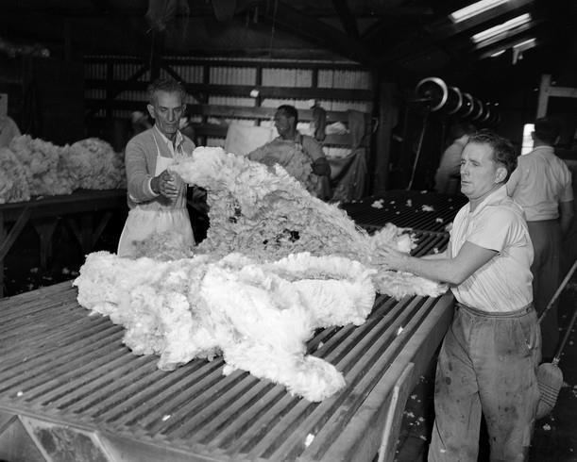
Farm workers laying out the freshly shorn fleeces in a farm's shearing shed.
Photographer: Laurie Richards

Slide 41
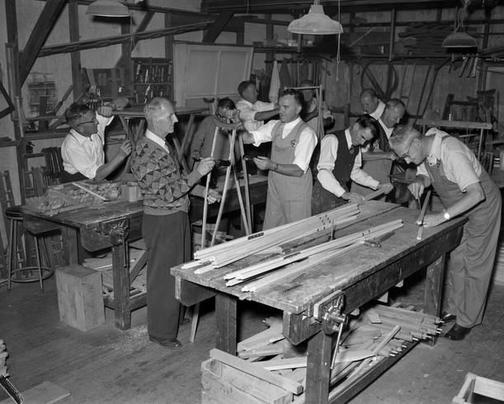
"Hartwell" a group of men carving, assembling and painting wooden crutches in a workshop.
Photographer: Laurie Richards

Slide 42
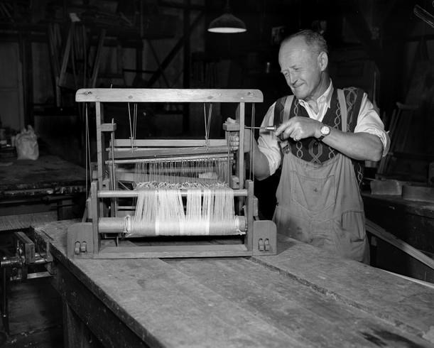
A man fixing a small hand loom with a screwdriver in a workshop
Photographer: Laurie Richards

Slide 43
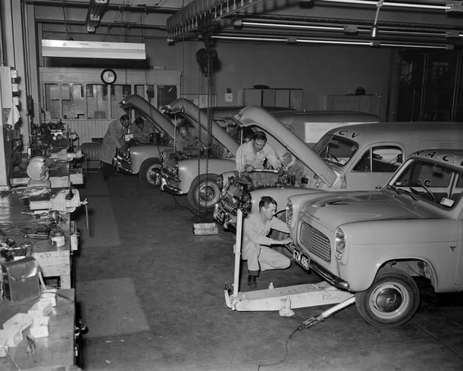
A group of male motor mechanics servicing a number of RACV roadside service cars and vans in a workshop at the RACV depot
Photographer: Laurie Richards

